Slide 1



New Procurement Framework
Standard Procurement Documents
PRIVATE SECTOR WEBINAR

Slide 2

Expectations
This webinar is being hosted in Washington, with participants joining us from across the globe
This webinar will take 2½ hours
Material will be delivered in approximately 10-20 minute segments
There will be opportunities to submit question following each segment

Slide 3



Webinar etiquette
only the presenters will speak during the webinar
please mute your microphone to reduce noise interference
we encourage you to submit questions at anytime, but especially during the designated question times
please only submit questions that relate to the webinar topic
we may not have time to answer all questions, but we will send you a full Q&A after the webinar
to submit a question please use the Webex ‘chat’ facility
participants in DC may also submit questions in writing on the form provided
sorry, but we are not able to take verbal questions
chat

Slide 4
Topic: new Standard Procurement Documents
Content
Introduction and overview of the new Procurement Framework
How the SPDs were developed and why
Regulatory changes:
common to all SPDs for goods, works and non-consulting services
Request for Proposals: consulting services
Specific regulatory changes reflected in:
Request for Bids: goods, works and non-consulting services
New Request for Proposals: goods, works and non-consulting services
Out of scope for today
Selection Methods and choosing the appropriate SPD
Detailed look at competitive dialogue
Detailed look at how to make a procurement-related complaint

Slide 5

Any questions before we begin?

Slide 6


Introduction and overview
The new Procurement Framework

Slide 7
Vision
  “Procurement in Investment Project Financing supports borrowers to achieve value for money with integrity in delivering sustainable development”

Slide 8
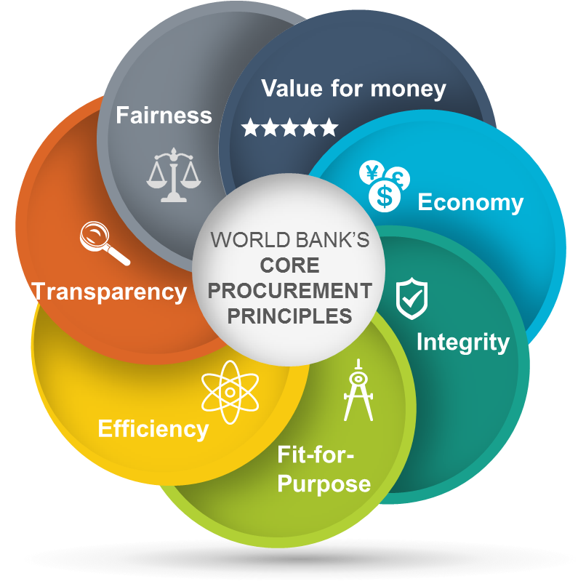
Principles

Slide 9
New Procurement Framework
Board control
management control
Policy
Directive
Procedures
Regulations
focus for today’s presentation
Sustainability toolkit
SPDs
Best practice guidance
Case studies
Tools and templates

Slide 10
Procurement Framework objectives
Modern procurement practice
Risk-based and proportionate
Fit-for-purpose
Achieve best value-for-money (VfM)
Better meets the clients’ and private sector needs
Encourage the right companies to participate
Leads to enhanced development outcomes

Slide 11

Procurement Regulations
Procurement Regulations for IPF Borrowers
In force from 1 July 2016
Regulations replace the ‘red’ and ‘green’ guidelines
Apply to goods, works, non-consulting and consulting services
Key features:
introduces Project Procurement Strategy for Development (PPSD)
enhances procurement procedures
enhances bidding documents by introducing SPDs
introduces new selection methods for GWNcS
differentiates between market approach options and selection methods
expands use of Framework Agreements
strengthens contract management

Slide 12
Greater focus on procurement planning
Project Procurement Strategy for Development (PPSD)
New market analysis and procurement planning tool
Risk-based approach
Addresses how the procurement will support development and deliver best value for money (VfM)
Forms the basis of the procurement plan
Proportional to the risk, value and complexity of the procurement
Short version for low-value, low-risk projects
Simplified version for emergency situations
Living document – can be updated periodically
Electronic procurement planning and monitoring system (STEP)

Slide 13
Questions?

Slide 14
Background to Developing The
Standard Procurement Documents

Slide 15
Standard Bidding Documents (SBDs) vs Standard Procurement Documents (SPDs)
SBDs vs SPDs
There are now 2 sets of documents = SBDs + SPDs
SBDs continue to be used for any project governed by the Guidelines
SPDs to be used for projects where the new Procurement Framework applies
Scope of application of SPDs
mandatory for international competitive procurements where the Project Concept Note is approved after 1 July 2016
may be used (as amended) for national competitive procurements, with the Bank’s agreement

Slide 16
The new Standard Procurement Documents
Standard Procurement Documents (SPDs)
23 SPDs launched 1 July 2016
In development:
RFP Works (Design + Build)
RFP Streamlined
RFP Competitive Dialogue
SPD Framework Agreement
Translations are underway (French and Spanish)
NOTE: Of the 23 launched 12 (relating to Works) have been updated to include Environment, Social, Health + Safety (ESHS) enhancements and published in January 2017. ESHS will be covered in detail in a separate seminar.
Notes:
8 docs in French and 1 doc in Spanish have been published

Slide 17
List of Standard Procurement Documents
Goods
RFB Goods (1 envelope)
RFB Goods (2 envelope)
PQD Health Sector (PVC)
RFB Health Sector (PVC)
RFB Education (Textbooks)
Works
RFB Small Works (1 envelope)
RFB Small Works (2 envelope)
RFB Large Works (without PQ)
PQD Large Works
RFB Large Works (after PQ)
RFB Roads (Output + Performance based)
Works French Civil Code
Plant
RFB Plant (without PQ)
RFB Plant (with PQ)
ISD Plant
RFP Plant (2 stage)
Acronyms
RFB = Request for Bids
PQD = Prequalification Document
RFP = Request for Proposals
ISD = Initial Selection Document

Slide 18
List of Standard Procurement Documents (cont.)
Consulting Services
RFP Consultancy Services
SPDs in development
ISD Works 2 stage (Design + Build)
RFP Works 2 stage (Design + Build)
ISD Streamlined universal
RFP Streamlined universal
ISD CD universal
RFP CD universal
SPQD Framework Agreement
RFB Framework Agreement
Other
PQD Management Services
RFB Management Services
RFB Non-Consultant Services
RFB Information Systems
ISD Information Systems
RFP Information Systems

Slide 19
Approach to developing the new SPDs
Method
SBDs modified to reflect the Regulatory changes
SPDs developed from existing SBDs
Opportunity to correct inconsistencies, update versions and apply enhancements
Important considerations
Kept good aspects of international competitive procurement e.g.:
international advertisement
pricing, use of foreign currencies, price adjustment, payment terms
international dispute resolution
use of international instruments e.g. INCOTERMS and URDG

Slide 20
How the SPDs were designed
  Key design features
Maintained existing category classifications i.e.:
goods
works
non-consulting services
consulting services
Maintained specialization within categories e.g.: goods still includes:
health = pharmaceuticals, vaccines and condoms
education = textbooks
information systems

Slide 21
How the SPDs were designed (cont.)
  Key design features (cont.)
Maintained structure of SBD documents e.g.:
Instruction to Bidders (ITB)
Bid Data Sheet (BDS)
Employer’s Requirements
Conditions of Contract
User’s Guides have been separated from SPDs
more concise User’s Guides for key SPDs are in development

Slide 22
Questions?

Slide 23

GOODS WORKS AND NON-CONSULTING SERVICES key changes reflected in all SPDs

Slide 24
Key changes common to all SPDs
  The next set of slides will cover the following key changes:
  New test to determine successful bid/proposal
  Abnormally Low Bid/Proposal
  Notification of Intention to Award, Standstill Period + debrief
  Procurement-related complaint (against decision to award the contract)
  Anti-corruption Guidelines
  Sustainable procurement
  Business Day
  Eligibility of SOEs
  Eligibility of cross-jurisdictional procurements
  Value Engineering

Slide 25
New test to determine the successful bid/proposal
SPD NEW
features
  Most Advantageous Bid/Proposal
  PPSD informs evaluation methodology
  Criteria to be appropriate to the nature and complexity of the procurement to allow the borrower to achieve VfM
  New test = “most advantageous bid/proposal” (details in later slides)
  For RFP the lowest evaluated cost alone may not necessarily represent best VfM
Notes:
VfM = the effective, efficient, and economic use of resources, which requires the evaluation of relevant costs and benefits, along with an assessment of risks, and non-price attributes and/or life cycle costs, as appropriate

Slide 26
SPD NEW
features
Abnormally Low Bid/Proposal
  Enhanced provisions based on MDB Working Group findings
  Modified definition of ALB/P:
Where the price, in combination with other elements, appears unreasonably low, to the extent that it raises material concerns as to the bidder’s/proposer’s capability to perform the contract for that price
  The 5 stages in managing an ALB/P:
Identify: borrower identifies a potential ALB/P
Clarify: borrower seeks clarification from the bidder/proposer
Justify: bidder/proposer prepares a justification of the price
Verify: borrower analyzes the justification to verify if it provides reasonable explanation and validation of the price
Decide: borrower decides whether to accept or reject the bid/proposal.

Slide 27
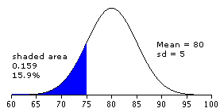
SPD NEW
features
Case study: Identification of ALB/P
  Identification: Scenario 1
  Fewer than five compliant bids/proposals: Identification based on a comparison of the adjusted bid/proposal price, and its constituent parts, with the borrower’s own cost estimate.
  Identification: Scenario 2
  At least five compliant bids/proposals: ALB/P risk zone is more than one standard deviation below the average of the compliant bids/proposals received.
Example Bids | $M
Bid 1 | 72
Bid 2 | 92
Bid 3 | 82
Bid 4 | 101
Bid 5 | 53
Average | 80
Standard Deviation | 17
ALB/P threshold | 63
ALB/P risk zone
63 80

Slide 28
SPD NEW
features
Notification of Intention to Award (NIA)
  Once borrower decides who to award contract to it must inform other bidders/proposers
  Send NIA to each bidder/proposer that submitted bid/proposal (but not to those who have previously been told they were not successful)
  Sending NIA starts the standstill period
  NIA must include:
details of the successful bidder + the contract price
names of all other bidders and their prices
statement why recipient was not successful
instructions on how to request a debriefing
date Standstill Period will end

Slide 29
SPD NEW
features
Standstill Period
  A period of 10 Business Days, from date NIA sent, where borrower cannot award the contract
  Allows unsuccessful bidders/proposers time to decide if they want:
a debrief
to lodge a complaint against the decision to award the contract
  Standstill Period can be extended in certain circumstances
  Circumstances where Standstill Period does not apply:
only one bid/proposal submitted
direct selection
call-off under framework agreement
emergency situation

Slide 30
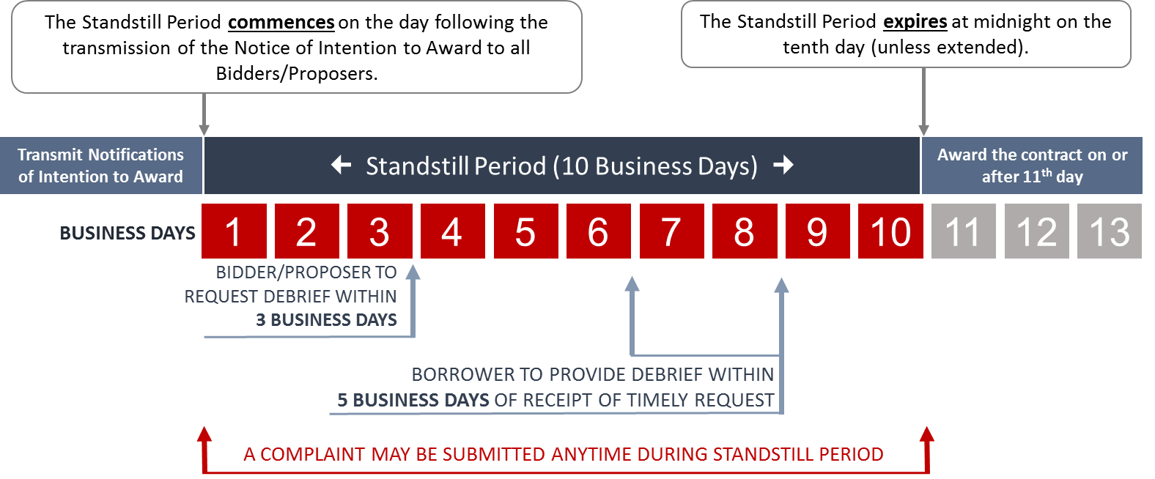
SPD NEW
features
Standstill period timeline

Slide 31
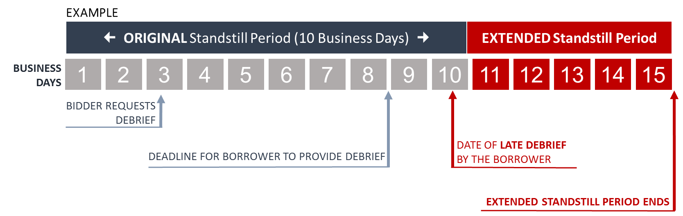
SPD NEW
features
Extended standstill period
  Bidder/proposer submits request for a debrief
  Borrower unable to provide debrief within 5 Business Days
  Standstill Period extended to 5 Business Days after the debrief takes place

Slide 32
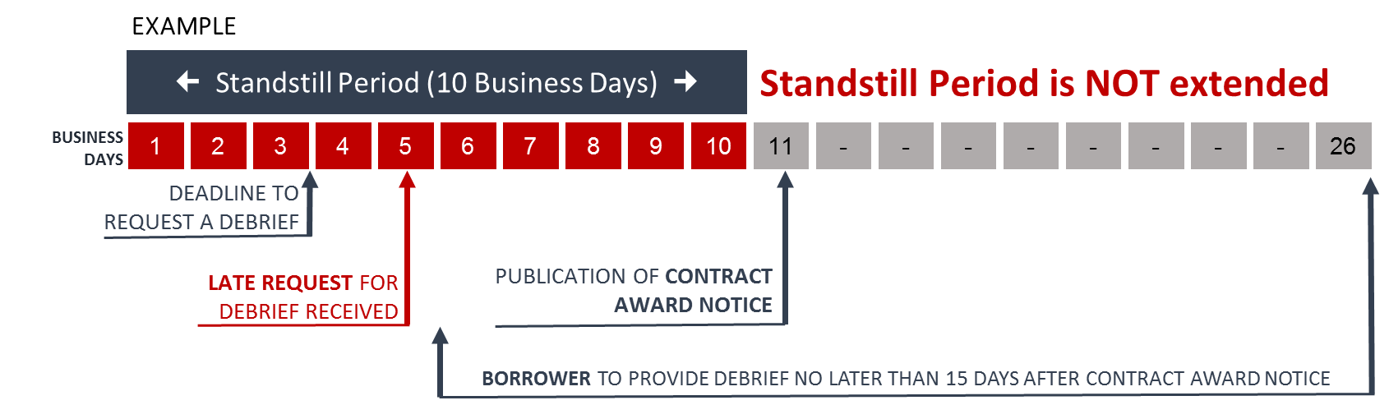
SPD NEW
features
Late request for debrief
  If bidder/proposer submits a late request for a debrief
  Borrower to provide debrief as soon as possible
  Normally no later than 15 Business Days after publication of the Contract Award Notice

Slide 33
SPD NEW
features
Complaints where SPDs apply
  How to handle complaints where SPDs apply
  Procurement Regulations Annex III sets out:
  3 circumstances when complaints can be made
  4 requirements for a complaint to qualify
borrower’s process and timelines for handling these complaints
roles and responsibilities for complainant, borrower and Bank
  3 circumstances – complainant can challenge:
  procurement documents
  decision to exclude the complainant from the process
  decision to award the contract (during Standstill Period)

Slide 34
SPD NEW
features
Complaints where SPDs apply (cont.)
  4 essential requirements:
  1. Who can complain?
  Complainant must be an ‘interested party’
  2. In what circumstances?
  The circumstances giving rise to the complaint must be relevant to the procurement - there are 3 three relevant circumstances
  3. When to make the complaint?
  Complaints must be made in a ‘timely manner’ - Regulations set the time limits that apply
  4. What information must be included?
  Regulations prescribe the minimum information that must be included in the complaint
Notes:
Complaints during the Standstill Period
Can challenge the borrower’s decision to award the contract
Must submit complaint before the expiry of the Standstill Period
Do not need to have requested/received a debrief
Borrower will acknowledge complaint within 3 Business Days
Borrower will respond to complaint with 15 Business Days of receipt
If complaint upheld:
borrower may change the contract award recommendation
borrower transmits revised intent to award
Refer to separate seminar on June 8th
Guidance on How to complaint
efe

Slide 35
SPD NEW
features
Complaints where SPDs apply (cont.)
  Complaints during the Standstill Period
  Can challenge the borrower’s decision to award the contract
  Must submit complaint before the expiry of the Standstill Period
  Do not need to have requested/received a debrief
  Borrower will acknowledge complaint within 3 Business Days
  Borrower will respond to complaint with 15 Business Days of receipt
  If complaint upheld:
  borrower may change the contract award recommendation
  borrower transmits revised intent to award

Slide 36
SPD NEW
features
Anti-corruption provisions
  Bank’s Anti-corruption provisions continue to be included in full in each SPD:
defining the sanctionable practices of corruption, fraud, collusion and coercion
sanctioning those engaged in sanctionable practices
declaring ineligibility of those sanctioned in according with WB prevailing sanctions policies
requiring Bank’s right to inspect
  Where SPDs are not used (i.e. alternative procurement arrangements, national competitive procurement and PPP), bidders/proposers will be required to accept the application of, and agreed to comply with, the Bank’s Anti-corruption provisions
Notes:
Bank’s Anti-corruption provisions are contained in full in each SPD:
defining the sanctionable practices of corruption, fraud, collusion and coercion
sanctioning those engaged in sanctionable practices
declaring ineligibility of those sanctioned in according with WB prevailing sanctions policies
requiring Bank’s right to inspect

Slide 37
SPD NEW
features
Sustainable procurement
  Regulations support application of sustainable procurement
  Sustainable procurement requirements beyond the Bank’s policies (e.g. environmental and social) are optional – at borrower’s discretion and as agreed with the Bank
  Application must be consistent with Bank’s Core Procurement Principles and the borrower’s own policies
  May include sustainable procurement in:
technical specifications and/or business or performance requirements
evaluation criteria
contract terms and conditions, if relevant
  Application in evaluation
  RFB normally (i) pass/fail and/or (ii) convert to monetary terms
  RFP normally assessed using combination of pass/fail and rated criteria

Slide 38
SPD NEW
features
Business Day
  In SPDs a ‘day’ is a calendar day, unless it is specified as a ‘Business Day’
  A Business day is any day that is an official working day of the borrower - it excludes the borrower’s official public holidays.
  Business Day is clearer for the market
  Examples of when Business Days apply:
time allowed for the preparation and submission of bids/proposals/expressions of interest
the calculation of the Standstill Period
the period within which bidders/proposers may request a debrief
minimum period before financial proposals may be opened following notification of results of technical evaluation.
  Contract conditions continue to be based on calendar days

Slide 39
SPD NEW
features
Eligibility SOEs
  Eligibility test is now:
  SOEs of the borrower’s country may be eligible to compete, and be awarded contracts, only if they can establish, in a manner acceptable to the Bank, that they:
  1. are legally and financially autonomous
  2. operate under commercial law
  3. are not under supervision by the agency contracting them
  The requirement of ‘dependency’ on the borrower has been replaced with ‘supervision’ of the contracting entity
  The ability to be contracted on an exceptional basis has been extended to include SOEs
  This exception has been expanded beyond consulting services to cover GWNcS

Slide 40
SPD NEW
features
Eligibility cross-jurisdictional procurement
  When a procurement involves more than one country
  Basic position: a firm, individual or goods from one country may be excluded by the borrower, if legally the borrower’s country prohibits commercial relations with that country
  New provision: where a procurement is implemented across jurisdictional boundaries (more than 1 country is involved) then:
  1. this type of exclusion, by one country, may be applied to the procurement across the other countries
  but only if:
  2. the Bank, and all other borrowers, agree

Slide 41
SPD NEW
features
Value Engineering (VE)
  VE is a systematic and organized approach to increase efficiency or effectiveness by changing materials to reduce cost, or process to reduce time, without sacrificing necessary functionality
  In SBDs the only reference to VE is the clause in the FIDIC conditions of contract for large Works and Management Services
  Procurement Regulations expand use, as appropriate, and as agreed in the PPSD
  Examples:
for RFBs VE can be applied during contract implementation
for RFPs, this option can also be used at the pre-contract award stage

Slide 42
Questions?

Slide 43
CONSULTING SERVICES updated Request for Proposal

Slide 44
Updated RFP Consulting Services
  No significant changes – we have maintained
  Shortlisting process
  RFP document structure and language
  Selection methods (e.g. QBS FBS LCS)
  Minimum changes to reflect the Regulations
  Inclusion of common provisions e.g. Notification of Intention to Award, Standstill Period, debrief
  Shortlisting:
removed the restriction of no more than 2 firms from one country
changed maximum of 6 to a range = between 5 and 8
NOTE: Consulting Services SPD, where it relates to supervising engineer, has been updated to include Environment, Social, Health + Safety (ESHS) enhancements and published in January 2017.

Slide 45
GOODS WORKS AND NON-CONSULTING SERVICES key changes - RFBs

Slide 46
RFB SPDs – key structural changes
  RFB structural changes
  Maintained RFB document structure and language
  Maintained prequalification, now separate RFB SPDs for use:
without Prequalification (for Plant and large Works)
after Prequalification
  Discontinued two-stage for plant (this is now RFP Plant)
  Removed User’s Guide from SPDs (plan to issue as separate documents)
  Introduced two envelope process (currently available for Goods and Small Works)
  Updated existing Prequalification documents for:
  works
  management services
  health sector goods

Slide 47
RFB GWNcS
new features
Modified test for successful bid
  Most Advantageous Bid (MAB)
When rated criteria are NOT used: example Request for Bids
The most advantageous bid is the bid:
1. of the bidder that meets the qualification criteria, and
2. whose bid has been determined to be:
  substantially responsive to the RFB document, and
  the lowest evaluated cost

Slide 48
GOODS WORKS AND NON-CONSULTING SERVICES key changes - new RFPs

Slide 49
New RFP SPDs for goods, works and non-consulting services
  Applied in competitive procurement
  Borrower describes requirements in terms of functionality/ performance and the market proposes solutions
  Supplier proposes a solution
  Select the appropriate SPD based on the category of GWNcS and risk, size and complexity of procurement
  Where appropriate, Bank agrees to using Best and Final Offer (BAFO) or Negotiation
  Can be used where borrower has capacity to undertake RFP procurement

Slide 50
RFP SPDs – key characteristics
  RFP SPDs for GWNcS - key characteristics
  complexity: non-standard procurement, or where complexity is moderate to high and cost of bidding is high
  market generated solutions: the market is able to offer customized solutions that are fit-for-purpose and deliver the desired performance/outcome
  innovation: high potential for innovative solutions
  value-for-money (VfM): the use of quality/cost evaluation rated criteria will lead to enhanced VfM
  flexibility: the borrower wants the supplier to have a greater degree of flexibility and/or control over design and/or delivery
  quality: quality of design and/or execution are important priorities

Slide 51
RFP SPDs – key structural changes
  New Initial Selection document (a form of shortlisting)
  New RFP SPD documents based on existing SBDs
  3 model RFP SPDs
  New terminology = “Proposer” and “Proposal”
  Single and multi-stage approaches
  Two envelope processes
  RFP 2 Stage approach for:
  plant (currently available)
  information systems (currently available)
  large works (design + build) (in development for)

Slide 52
Three model RFP SPDs
  Three RFP SPDs for GWNcS
  Each has been developed for different scenarios - from complex to very complex procurement
  Universal RFP SPDs
  Historically the Bank has developed SBDs and SPDs based on:
common procurement categories e.g.: textbooks, works, plant
with features appropriate to the category, selection method and perceived complexity, size and risk in the procurement
  Universal RFP SPD is planned to be category neutral
  Streamlined and Competitive Dialogue are planned to be universal
  Design and scoping document in development

Slide 53
Streamlined RFP (currently in development)
  Key features:
Single-stage plus Initial Selection
Borrower is able to describe the result/outcome to be achieved
Borrower is seeking customization of existing solution/s or a new or alternative solution
No “Discovery” or “Dialogue” phases
BAFO or Negotiation used, if appropriate
Independent probity assurance provider is mandatory if BAFO or Negotiation and closed opening are used
Faster than RFP Two-stage and Competitive Dialogue
CASE STUDY: Problem: Borrower needs a solution to transport foot and motor vehicle traffic over a river.
Solution: Borrower has decided it wishes to build a bridge. It is looking for proposals that represent best VfM.

Slide 54
Two-stage RFP
  Key features:
Two-stage plus Initial Selection
Independent probity assurance provider is strongly advised
Borrower can describe the desired result/outcome, but can’t fully describe the solution or wants market to propose options
Borrower is seeking innovation in design of technical solution and/or delivery or implementation
Borrower wishes to explore proposed solutions with each Initially Selected applicant. Allows a “Discovery” phase for 1-on-1 discussions with proposers
Borrower may need additional specialist expertise
BAFO or Negotiation used, if appropriate
Takes more time and resources than RFP Streamlined, but not as much as RFP Competitive Dialogue
CASE STUDY: Problem: Borrower needs a solution to transport foot and motor vehicle traffic over a river.
Solution: Borrower has decided it wishes to build a bridge. It is looking for proposals that represent best VfM and optimize proposed solutions.

Slide 55
Competitive Dialogue RFP (currently in development)
  Key features:
Multi-stage plus Initial Selection
Independent probity assurance provider is mandatory
Borrower is able to describe the problem to be solved, and/or the result/outcome to be achieved
Solutions are not available in the market place, or
Difficult to determine the best financial/commercial terms and/or legal/contractual framework
Includes “Dialogue” phase for 1-on-1 discussions with proposers
Borrower needs high level of procurement capacity - may need additional specialist expertise
BAFO or Negotiation used, if appropriate
Takes the longest of all RFPs and involves borrowers and proposers investing considerable resources and expense
CASE STUDY: Problem: Borrower needs a solution to transport foot and motor vehicle traffic over a river.
Solution: Borrower does not know if the best solution is a ferry service, bridge, tunnel, or some other innovative novel or unique solution.

Slide 56
When to use which RFP SPD
HIGH
RFPs for GWNcS
  Fit-for-purpose by design
Getting the best fit-for-purpose procurement process means choosing the most appropriate Selection Method
RFP
Competitive Dialogue
RFP
Two-stage
COMPLEXITY AND RISK
IN THE GRAPH:
y axis = levels of complexity and risk in the procurement and time to undertake the procurement
x axis = how easy/difficult is it to define:
1. the outcome to be delivered, and
2. how the contract, ffinancing + commercial deal will be structured
RFP
Streamlined
RFB
LOW
DIFFICULT
EASY
EASE IN DEFINING OUTCOME/S + COMMERCIAL DEAL

Slide 57
RFP SPDs – key content changes
  The following slides will cover:
  Initial Selection process and rated criteria
  Performance based specifications
  BAFO or Negotiation option
  Two-envelope process
  Closed opening
  VfM – combination of life cycle costing and rated criteria
  New test - Most Advantageous Proposal (MAP)

Slide 58
New RFP + Initial Selection process
  New Request for Proposals
  Introduced for goods, works and non-consulting services (GWNcS)
  Key features:
introduces Initial Selection (short listing)
optimizes use of rated evaluation criteria
promotes functional/performance based specifications
encourages innovation and new solutions
  Initial Selection
“The shortlisting process used prior to inviting Request for Proposals in the procurement of Goods, Works or Non-consulting Services.”

Slide 59
RFP Selection Method for GWNcS
  New RFP – why?
  Offers greater flexibility in designing fit-for-purpose procurement process
  Evaluates quality of proposals, in conjunction with cost
  Decision to use RFP Selection Method based on:
  Nature and complexity of the procurement
  PPSD and Procurement Plan
  Sufficient time to undertake a longer RFP procurement process
  The borrower’s capacity to:
develop functional based specifications + monitor their implementation
develop and apply rated criteria and methodology

Slide 60
Initial Selection
The RFP SPDs have been designed to work in conjunction with Initial Selection
  Regulations: “Initial Selection shall normally be used with RFP method for GWNcS”
  “normally” means there must be a good business reason not to use Initial Selection
  Rationale
  Initial Selection enables borrower to invite only the highest ranked applicants to submit proposals
  Fairer to the market as only applicants that have the best chance of succeeding are put to the time and cost of submitting full proposals
  Improves quality of proposals and participation
  Makes the RFP process more manageable for the borrower

Slide 61
Initial Selection and Prequalification
  Difference between Initial Selection and Prequalification
  Prequalification = select all substantially qualified Applications
  Initial Selection = select only the best (highest scoring) qualified Applications

Slide 62
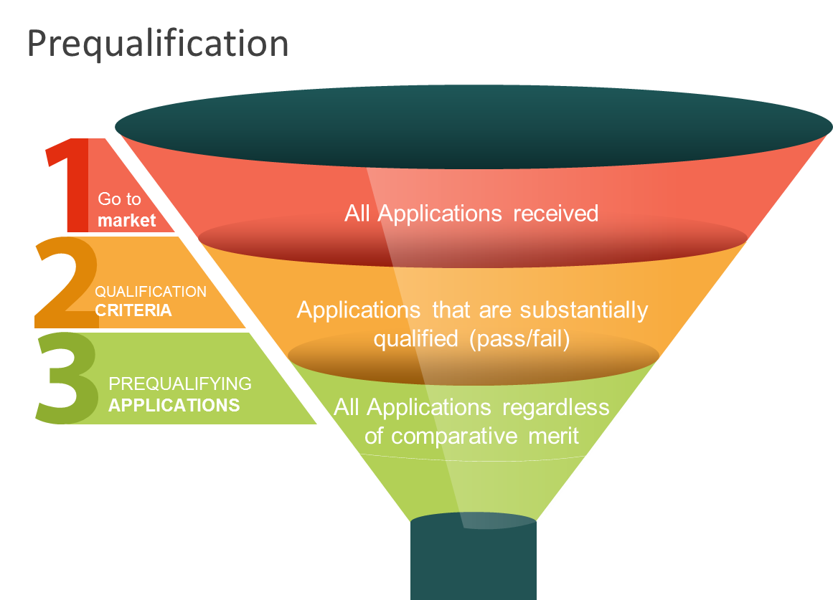
Prequalification

Slide 63
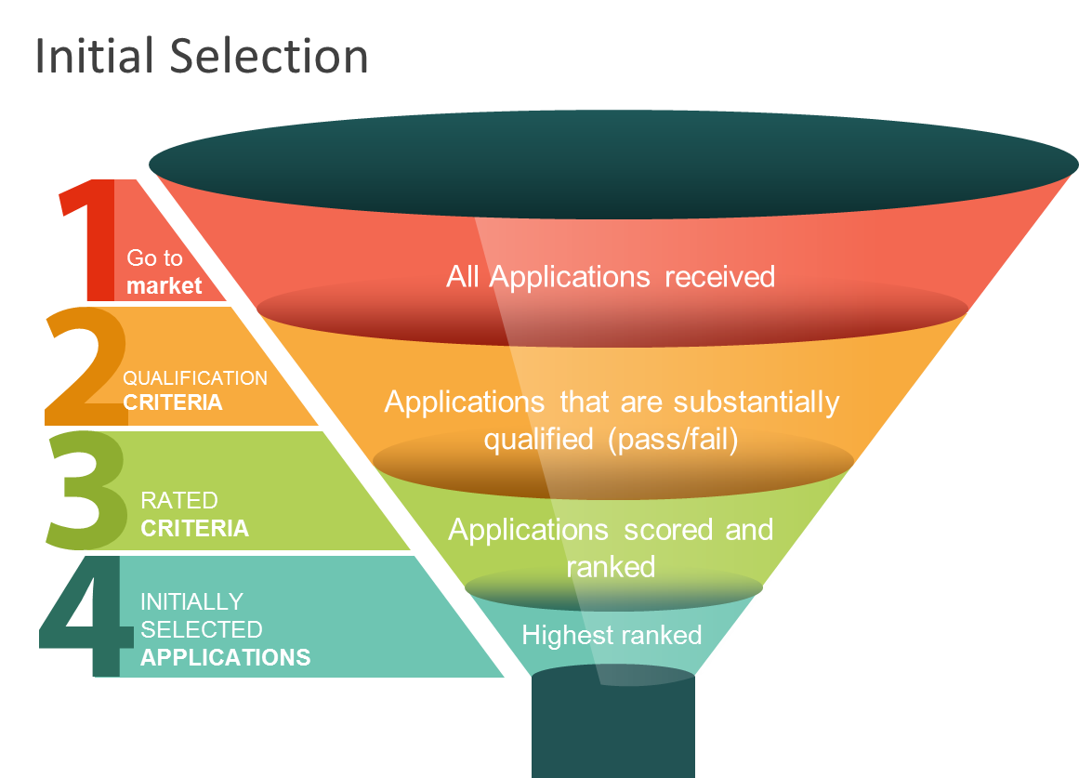
Initial Selection

Slide 64
Range of Applications Initially Selected
  Set the range based on factors identified in PPSD:
  Diversity and maturity of market
  Complexity and/or novelty of the GWNcS being procured
  Level of effort required by proposers and borrower
  Not too few - need to maintain competitive tension
  Not too many - proposers need confidence that they have an increased chance of winning:
fosters quality of proposals
encourages strong commitment to the process
too many defies the purpose of Initial Selection
Note: range should be reasonable given nature + complexity of the procurement and market

Slide 65
Case study: Initial Selection
  Evaluation and Initial Selection
  14 Applications are received. Only 11 Applications are substantially qualified
  These 11 are evaluated against the rated criteria and ranked according to their scores
Notes:
Initial Selection
The borrower Initially Selects the first four top scoring Applications
Elimination
The borrower eliminates Applications ranked 9th, 10th and 11th as they exceed the maximum number
Borrower’s discretion
The borrower has discretion to Initially Select Applications ranked from 5th to 8th
In this case study two Applications have the same scores, and are ranked 5th equal
The borrower decides to Initially Select both of these Applications

Slide 66
RFP GWNcS
new features
Rated criteria
  Benefits of rated criteria
  Rated criteria are weighted and evaluated using a scoring system
  Allows objective comparison of quality between different solutions
  Rated criteria may be applied to:
identify the highest scoring proposed solutions
assess innovative solutions
criteria that cannot be expressed in monetary terms
  Rewards proposals that exceed minimum requirements and demonstrate best overall VfM
  Decision to award contract is based on the optimum combination of quality + cost

Slide 67
Rated criteria (cont.)
  To minimize subjectivity:
criteria should be material and relevant to the needs
each criterion should be clearly described
scoring methodology should be appropriate to the nature + complexity of procurement
weightings are based on relative importance
include the criteria, scores and scoring methodology in the Initial Selection/RFP document - proposers should be fully informed
  Ensure:
  borrower has capacity to develop rated criteria and scoring methodology
  evaluation panel understands how to apply the criteria and methodology
  evaluation report details the scoring and justifies the recommendation

Slide 68
RFP GWNcS
new features
Performance based specifications
  RFP Selection Method promotes performance based specifications
  RFP
  Performance specifications: borrower describes the outcome or results to be achieved in terms of business or functional performance requirements
  RFB
  Conformance specifications: borrower describes in detail the technical requirements of the design, method of production, construction and/or delivery or implementation

Slide 69
RFP GWNcS
new features
Best and Final Offer (BAFO)
  An option in international competitive procurement where borrower requests BAFOs
  Used following evaluation and before contract award, when the procurement would benefit from bidders/proposers having a final opportunity to improve their bids/proposals
  Must signal in the procurement document that BAFO may be used
  Borrower’s discretion to use will depend on market response
  If used, bidders/proposers are not required to submit a BAFO
  There cannot be Negotiation after BAFO
  If BAFO is used must employ independent Probity Assurance Provider
  Probity report shared with Bank, sent to proposers and published on borrower’s website
BAFO and Negotiation are mutually exclusive
i.e. you cannot use both in a single procurement

Slide 70
RFP GWNcS
new features
Negotiation
  An option, in international competitive procurement, that allows the borrower to conduct a negotiation following evaluation and before contract award
  Must signal in the procurement document that Negotiation may be used
  Borrower’s discretion to use will depend on market response
  Negotiation may address terms and conditions, price, social/ environmental aspects + innovation
  BUT must not materially change the borrower’s requirements
  Sequence:
  must negotiate first with the bidder/proposer with the MAB/P
  if outcome unsuccessful, negotiate with next MAB/P
  Must be held in presence of independent probity assurance provider
  Probity report is shared with the Bank

Slide 71
RFP GWNcS
new features
2 envelope process
  What is the 2 envelope process?
  Technical parts and financial parts of bids/proposals put in separate envelopes
  Both envelopes are submitted simultaneously before the deadline
  At first opening only technical envelopes opened – financial envelopes are kept in safe custody
  At second opening financial envelopes (for technically qualified bids/proposals) are opened
  Why have a 2 envelope process?
  Evaluation of technical parts is not influenced by price
  In BAFO/Negotiation helps maintain competitive tension between bidders/proposers

Slide 72
RFP GWNcS
new features
Closed opening
  Default position = maintain practice of public openings for both technical and financial parts
  Exception = closed opening with probity auditor = option that may be applied:
  two-envelope process, with
  RFP for goods, works or non-consulting services
  where BAFO or Negotiation are applied
  Closed opening with probity auditor = new process when opening financial envelopes:
  opened in the presence of a probity assurance provider (not in public)
  auditor prepares a probity report
  deferred disclosure = at the same time as sending Notification of Intention to Award the borrower:
sends the probity report to proposers
publishes report on website

Slide 73
RFP GWNcS
new features
Closed opening (continued)
  Why closed opening and deferred publication of information?
  Proposers do not learn each others’ prices
  Maintains competitive tension while not compromising:
integrity = as done in presence of probity assurance provider
transparency = as full information is released later in the probity report
  Reflects modern commercial practice

Slide 74
RFP GWNcS
new features
Most Advantageous Proposal (MAP)
  New test to determine the successful proposal
When rated criteria are used: example Request for Proposals
The most advantageous proposal is the proposal:
1. of the proposer that meets the qualification criteria, and
2. whose proposal has been determined to be:
substantially responsive to the RFP document, and
the best evaluated proposal (i.e. the highest scored proposal)
In this scenario the MAP represents the best VfM, which may not be the lowest evaluated cost

Slide 75
Questions?

Slide 76
More private sector seminars
Topic | Location | Date | Time
Environment, Social, Health & Safety (ESHS) consideration in procurement | DC based webinar | June 6th 2017 | 8:00 – 10:00 am
How to Complain | DC based webinar | June 8th 2017 | 8:00 – 10:00 am
New Standard Procurement Documents | DC based Webinar (REPEAT of session of April 6th) | June 22nd 2017 | 8:00 – 10:00 am
New Standard Procurement Documents | DC based Webinar (REPEAT of session of April 6th) | June 27th 2017 | 8:00 – 10:00 pm (target audiences for whom the morning session is not convenient due to time zone differences)
Expanded session: SPDs, ESHS, how to complain | DC based webinar | September 2017 (date to be confirmed) | 8:00 am – 12:00 noon

Slide 77
More private sector seminars (cont.)
Topic | Location | Date | Time
Expanded session: SPDs, ESHS, how to complain | Regional Event Europe and Africa (locations to be confirmed) | October 2017 (dates to be confirmed) | 5 hours (to be repeated at various locations in the region)
Contract Management | DC based webinar | November 7th 2017 | 8:00 – 10:00 am
New Standard Procurement Documents | DC based Webinar (REPEAT of session of 6th April) | November 14th 2017 | 8:00 – 10:00 am
Competitive Dialogue | DC based webinar | November 23rd 2017 | 8:00 – 10:00 am
Expanded session: SPDs, ESHS, how to complain | Regional Event Latin America (locations to be confirmed) | December 2017 (dates to be confirmed) | 5 hours (to be repeated at various locations in the region)
Expanded session: SPDs, ESHS, how to complain | Regional Event East and South Asia (locations to be confirmed) | February 2018 (date to be confirmed) | 5 hours (to be repeated at various locations in the region)
Bank Corporate Procurement (including eConsultant2) | DC based webinar | (date to be confirmed) | 8:00 – 10:00 am

Slide 78
Useful links
World Bank’s Procurement Regulations for IPF Borrowers | https://policies.worldbank.org/sites/ppf3/PPFDocuments/Forms/DispPage.aspx?docid=4005
World Bank’s Procurement Policy | https://policies.worldbank.org/sites/ppf3/PPFDocuments/Forms/DispPage.aspx?docid=4002
Standard Procurement Documents templates | http://www.worldbank.org/en/projects-operations/products-and-services/brief/procurement-new-framework#SPD
Guidance on SPDs | http://www.worldbank.org/en/projects-operations/products-and-services/brief/procurement-new-framework
Guidance on how to complain | http://www.worldbank.org/en/projects-operations/products-and-services/brief/procurement-new-framework
Video: World Bank Procurement, How to bid, finding opportunities, what makes a successful bid | http://www.worldbank.org/en/news/video/2016/03/30/world-bank-procurement-video
Procurement App for IPad: Data on contracts | https://itunes.apple.com/us/app/world-bank-project-procurement/id911312962?mt=8
Procurement App for IPad: Data on projects, finances and procurement data | https://itunes.apple.com/us/app/world-bank-group-finances/id465555488?mt=8
UNDB Online | https://www.devbusiness.com/Search/Search.aspx?PreLoadProjects=1

Slide 79
For more information
http://www.worldbank.org/procurement
Operations, Policy and Country Services
Standards, Procurement and Financial Management Department
The World Bank
1818 H Street, NW
Washington, D.C. 20433 U.S.A.

Slide 80

Please give us your feedback
We hope you found the webinar helpful and interesting. We need your feedback to help us improve the design and delivery to future audiences
We also welcome your suggestions for additional webinar topics to be delivered in the future
Following this webinar you will receive an invitation, through Survey Monkey, to provide your feedback and suggestions. Please take the time to respond. Your feedback is important.

